Slide 1
Stormtime SAPS events: OpenGGCM-RCM-CTIM modeling and data comparisons
Joachim Raeder, Doug Cramer & Joseph Jensen (Space Science Center, UNH)
Frank Toffoletto & Stan Sazykin (Rice University)
Hien Vo (Vietnamese German University, Ho-Chi Minh City, Vietnam)
John Foster & Phil Erickson (MIT/Haystack)
Phil Anderson (UT Dallas)
European Geosciences Union General Assembly 2017, Vienna, Austria, 28 April 2017

Slide 2
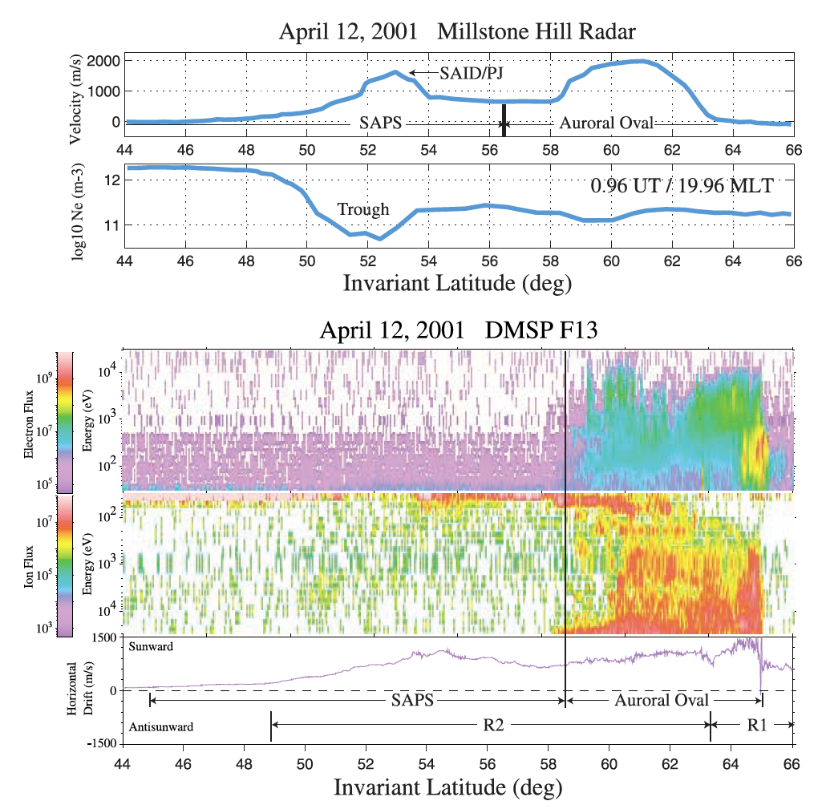
SAPS
Strong westward flows predominantly in the pre-midnight sector. Equivalent to a strong northward electric field (→ 50 mV/m ~ 1000 m/s).
Well separated from convection cell.
Equatorward of auroral precipitation (→ low conductance), 2-8 degrees wide.
Associated with a trough in electron density.
Associated with geomagnetic activity.
Associated with R2 field aligned currents (FAC).
Foster & Vo, JGR, 2002 →

Slide 3

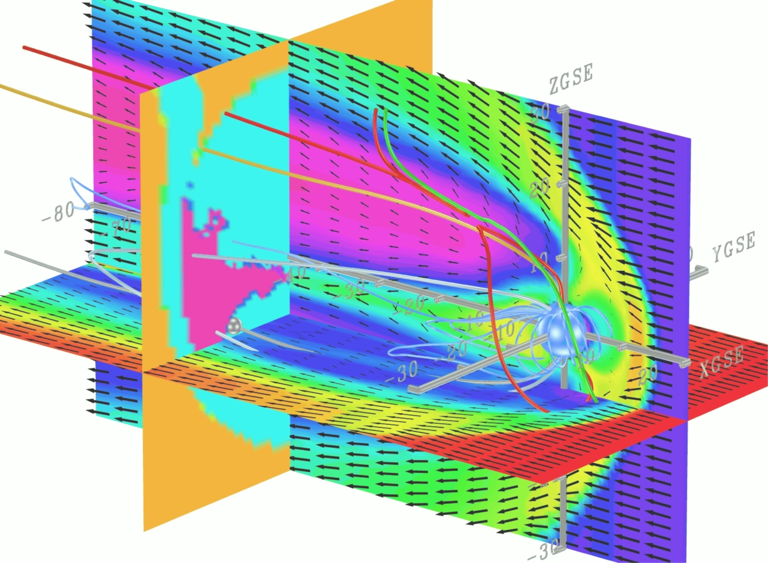
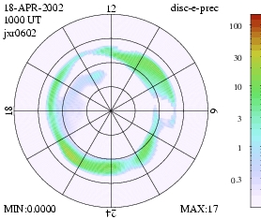
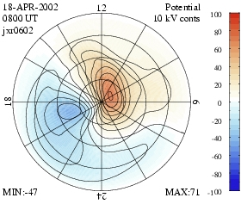
OpenGGCM: Global Magnetosphere Modeling
The Open Geospace General Circulation Model:
Coupled global magnetosphere - ionosphere - thermosphere model.
3d Magnetohydrodynamic magnetosphere model.
Coupled with NOAA/SEC 3d dynamic/chemistry ionosphere - thermosphere model (CTIM).
Coupled with inner magnetosphere / ring current models: Rice U. RCM, NASA/GSFC CRCM.
Model runs on demand (>500 so far) provided at the Community Coordinated Modeling Center (CCMC at NASA/GSFC).
http://ccmc.gsfc.nasa.gov/
Fully parallelized code, real-time capable. Runs on IBM/datastar, IA32/I64 based clusters, PS3 clusters, and other hardware.
Used for basic research, numerical experiments, hypothesis testing, data analysis support, NASA/THEMIS mission support, mission planning, space weather studies, and Numerical Space Weather Forecasting in the future.
Funding from NASA/LWS, NASA/TR&T, NSF/GEM, NSF/ITR, NSF/PetaApps, AFOSR programs.
Aurora
Ionosphere Potential
Personnel: J. Raeder, D. Cramer, K. Germaschewski, L. Wang, J. Jensen, S. Kavosi, B. Ferdousi, M. Tobin (UNH), T. Fuller-Rowell, N. Maruyama, T. Matsuo (NOAA/SEC), F. Toffoletto, S. Sazykin (Rice U.), M.-C. Fok, A. Bhatthacharjee (Princeton)

Slide 4
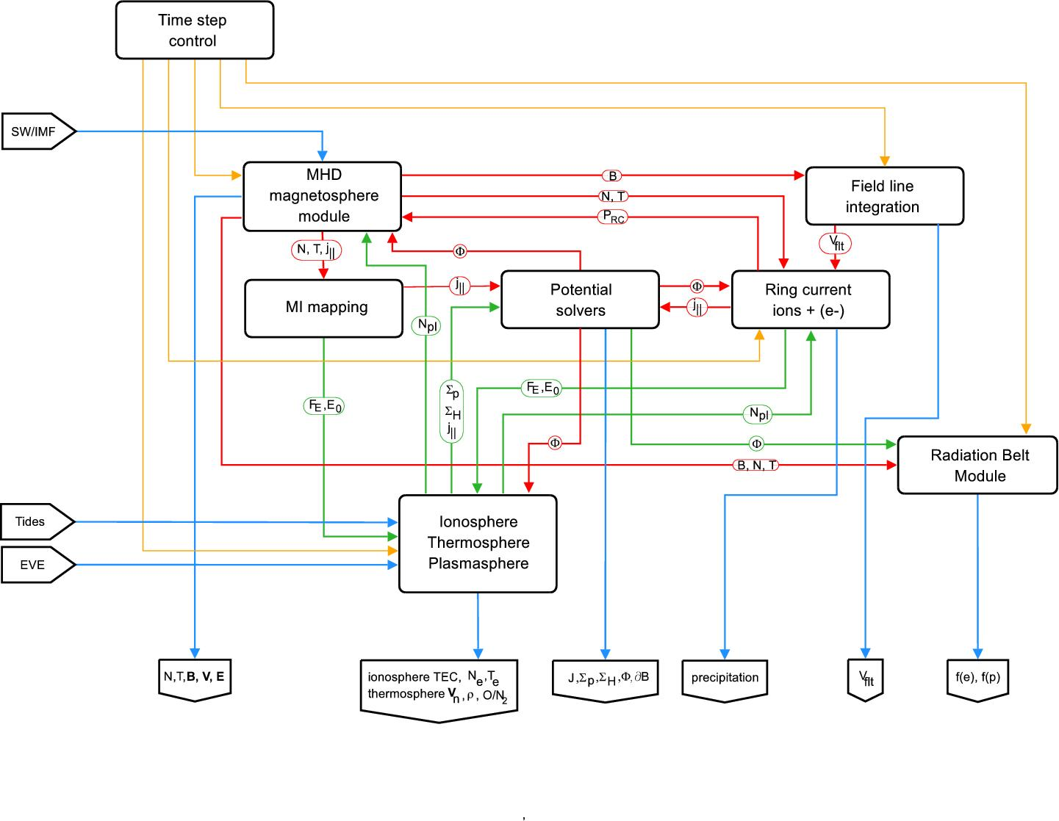
OpenGGCM-RCM-CTIM Model Data Flow
Self-consistent modeling of SAPS requires:
Solving the outer magnetosphere driver → convection E-field, precipitation, R1 FAC.
Proper solution of the inner magnetosphere → ring current, partial ring current, precipitation, R2 currents.
Proper IT modeling → e- densities, conductances, neutrals, recombination, etc.
All coupled with the appropriate feedbacks.

Slide 5
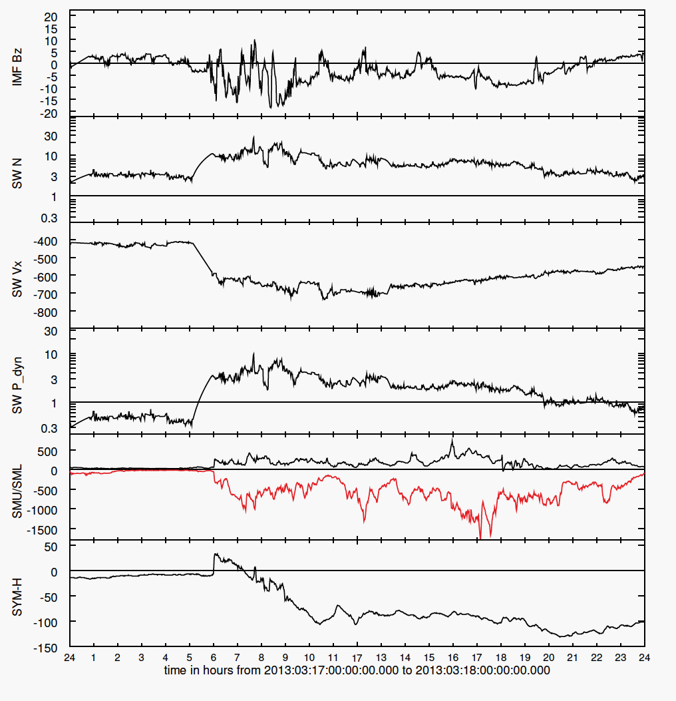
The 2013-03-17 Storm
CIR type storm.
Strong SSC.
Moderate dynamic pressure.
Moderate IMF Bz with few prolonged southward periods.
Slow development of main phase.
Here, we only consider main phase until ~1700 UT.

Slide 6
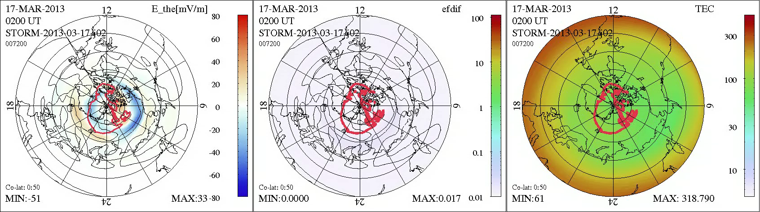
North-South E field, Precipitation, and TEC
The red line shows the polar cap boundary.
Thin contours are FAC.
PC expands quickly as IMF turns southward.
Strong northward electric field develops well equatorward of PCB, and just equatorward of of precipitation (current continuity and Ohm’s law).
TEC trough is co-located with electric field, but takes some time to develop.

Slide 7
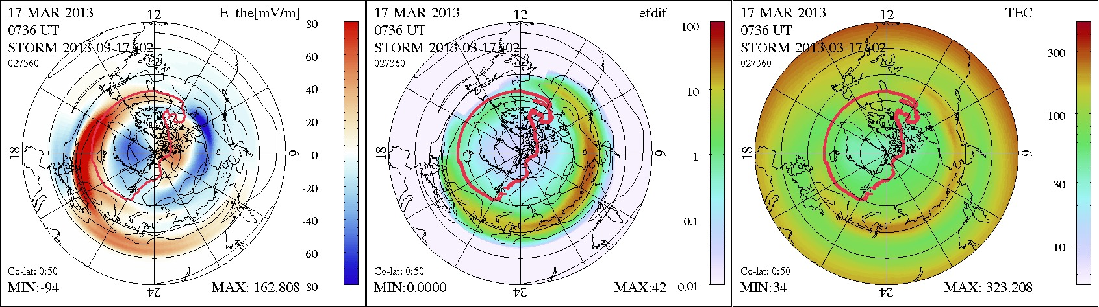
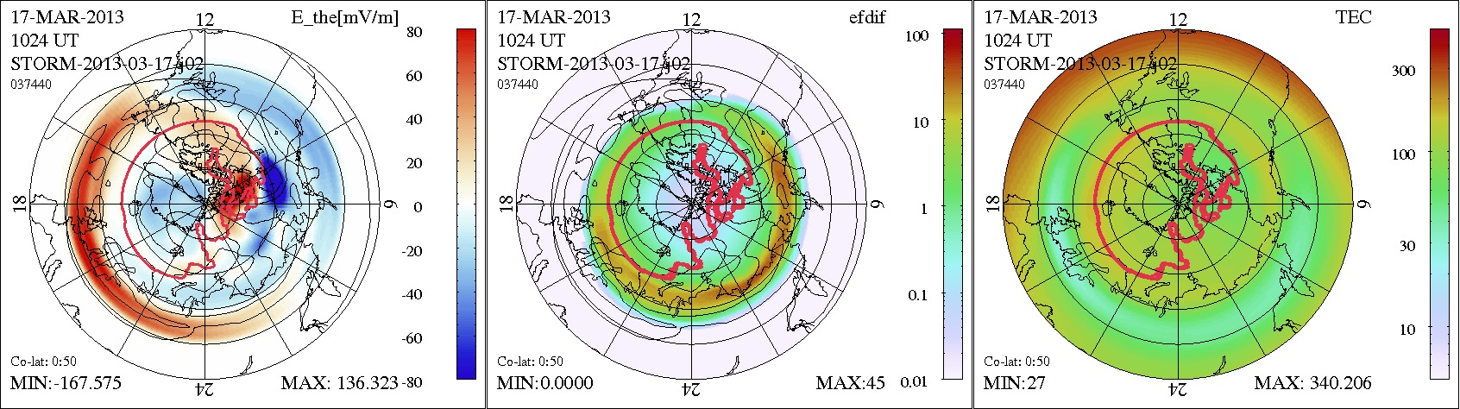
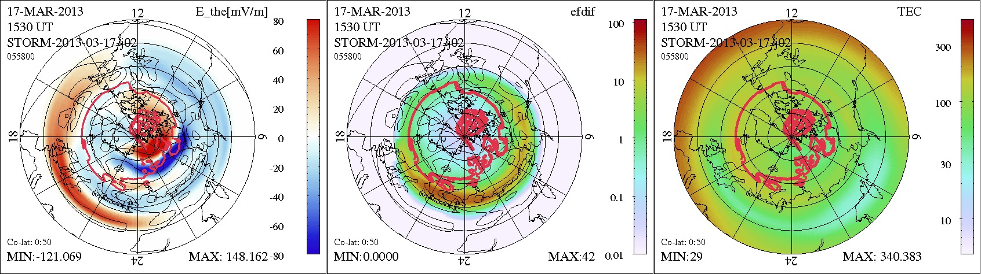
NS-Efield, Precipitation, and TEC
SAPS split into a dusk part and into a midnight part: transient effect during PC expansion.
Trough is fully developed in the storm main phase. Not much LAT(MLT) dependence of SAPS.
Trough later in the storm moves past midnight, where eastward flows dominate. This may just be a transport effect.

Slide 8
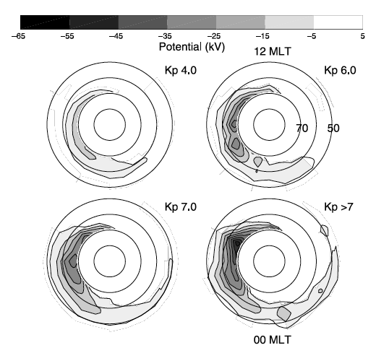
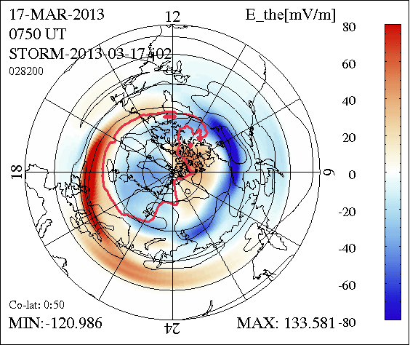
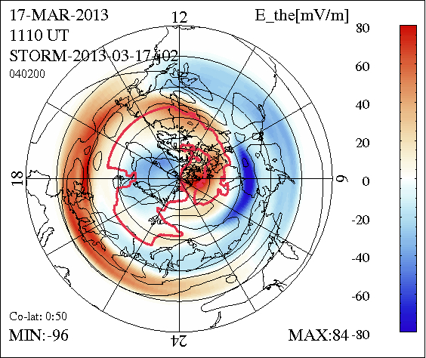
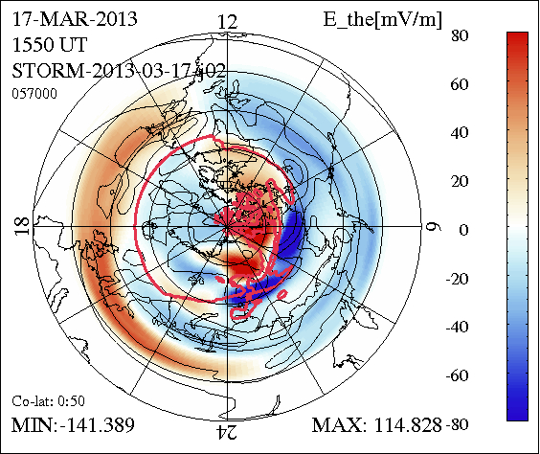
Comparison with Statistics
← Early main phase: SAPS at lower latitude at midnight.
Compare to statistics →
(Foster & Vo, JGR, 2002)
Mid and late main phase: SAPS at lower latitudes everywhere. →
~8º lower in latitude in the model than in the statistical result.

Slide 9
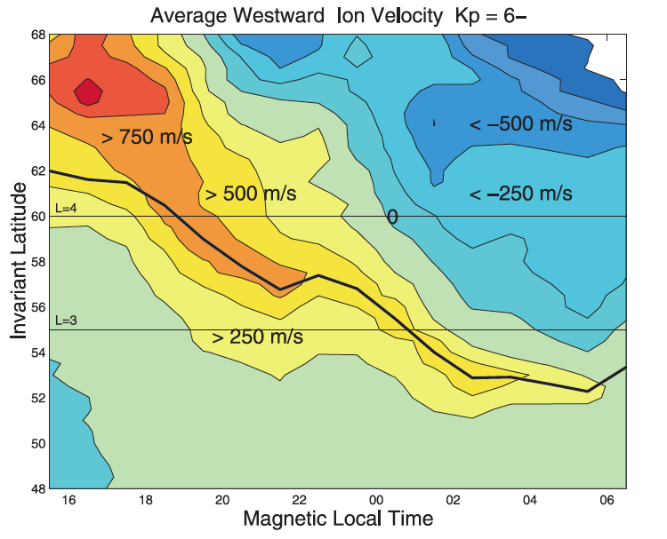
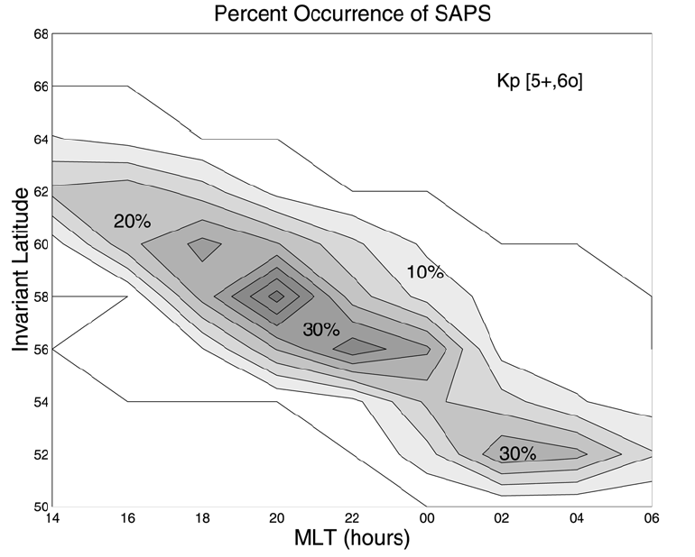
Comparison with Statistics
The latitude – MLT dependence is not only statistical but also occurs instantaneously. MLT-E dependence matches.
Foster & Vo, JGR, 2002

Slide 10
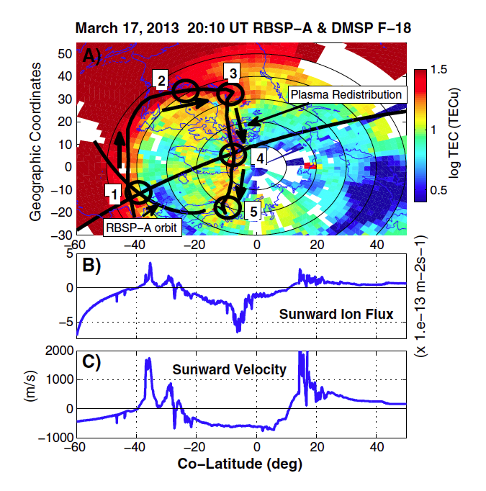
Storm Enhanced Density (SED)
Tongue of Ionization (TOI)
The sunward convection associated with SAPS drives plasma into the dayside (1).
High solar UV/EUV flux increases ionization and e- density (2), forming a region of storm enhanced density.
When the flow turns tailward again (3), it is driven to higher altitude due to field line inclination (4). This forms the Tongue Of Ionization (4,5).
We have yet to find this in the simulations. There are some issues with CTIM vertical transport, which should get resolved with IPE.
Foster et al., GRL, 2014 →

Slide 11
Summary and Conclusions
Coupled OpenGGCM-RCM-CTIM reproduces SAPS and their main characteristics: location, strength, latitude-MLT dependence, and e- trough.
All model components together are required to produce SAPS.
SAPS can split into two channels near midnight.
The latitude-MLT dependence (lower latitude near midnight) can be instantaneous.
The trough appears to drift eastward and outside of the region of SAPS later in the main phase.
Further investigations as to SW/IMF dependence, mechanisms, and feedbacks are now possible.
Raeder, J., W. D. Cramer, J. Jensen, T. Fuller-Rowell, N. Maruyama, F. Toffoletto, and H. Vo, Sub-Auroral Polarization Streams: A complex interaction between the magnetosphere, ionosphere, and thermosphere, Journal of Physics Conference Series, 767, 1-10, 2016. 012021, (DOI: 10.1088/1742-6596/767/1/012021).

Slide 12
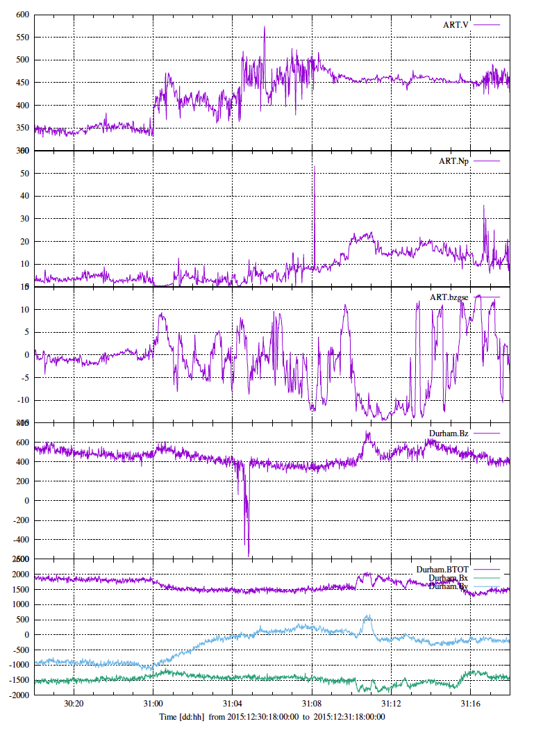
Space Weather with a Cell Phone
December 30/31, 2015 storm.
$10 cellphone in my backyard.
Noise ~50 nT for 1 minute averages.
My expensive cell phone is ~5 times better: 100 samples/s, ~10 nT noise when averaged to 1 minute.
There are >5B cell phones in the world.
Data are useless most of the time because phones move.
But when they don’t move they can catch something interesting.
The magnetometers in cell phones cost <$1!!

Slide 13
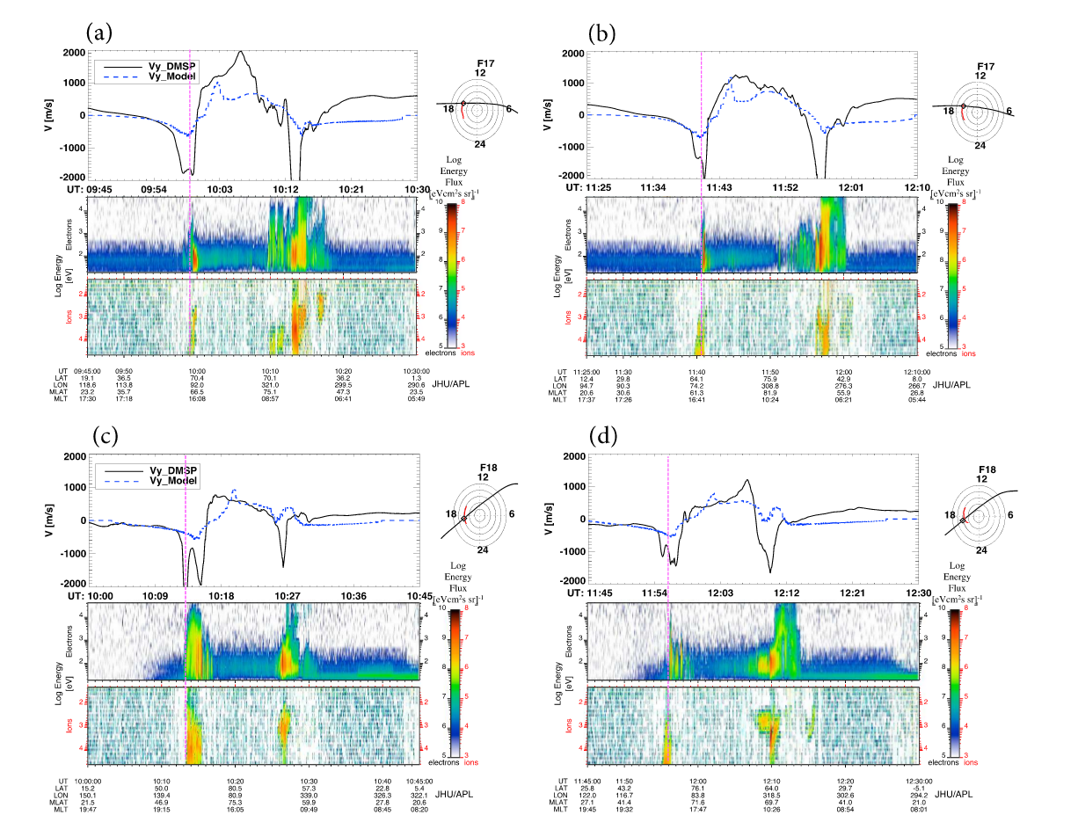
What is not SAPS
BATSRUS comparison w/DMSP data.
Note that 50 mV ~ 1000 m/s
OpenGGCM NS E-field is ~100 mV/m max.
Yu et al., 2015, using BATSRUS+SCB, JGR, 2015

